Slide 1
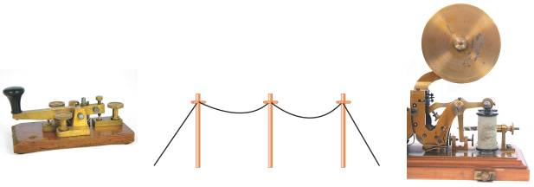
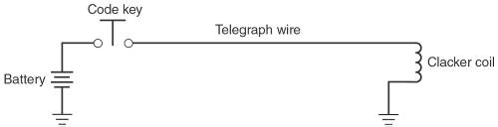
1-1 Introduction to Digital 1s and 0s
A large part of the worldwide telecommunications system falls in the category of “digital systems.”
It started as a simple digital system that used only two states to represent information.
A telegraph system consisted of a battery, a code key (normally open, momentary contact switch), a telegraph wire, and an electromagnetic “clacker.”

Slide 2
1-1 Introduction to Digital 1s and 0s
The telegraph system used two distinct “symbols” to transmit any word or number.
Short & long electric pulses, the dots & dashes of Morse code—a digital representation of information.
The electric signal is either on or off at all times.
This relates to modern digital systems that use electrical signals to represent 1s and 0s.

Slide 3
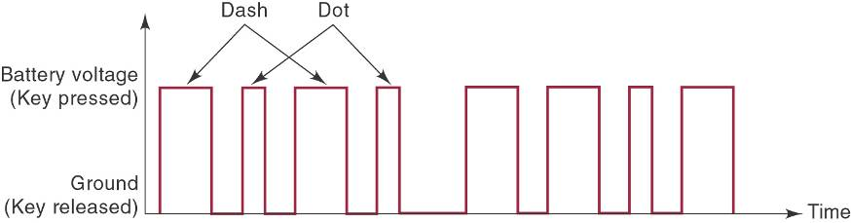
1-1 Introduction to Digital 1s and 0s
A timing diagram shows which state (1 or 0) the system is in at any point in time.
And shows the time when a change in state occurs.

Slide 4
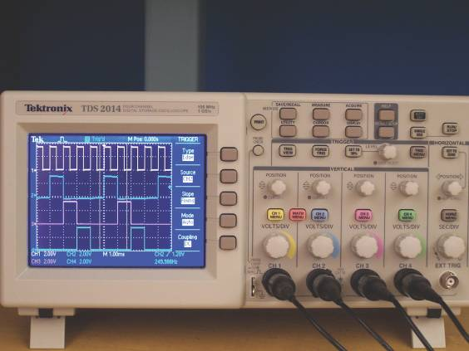
1-1 Introduction to Digital 1s and 0s
By displaying one or more digital signals using test instruments such as an oscilloscope, we can compare actual signals to expected operation.

Slide 5
1-2 Numerical Representations
Physical systems use quantities which must be manipulated arithmetically.
Quantities may be represented numerically in either analog or digital form.

Slide 6
1-2 Numerical Representations
Analog Representation—a continuously variable, proportional indicator.
Sound through a microphone causes voltage changes.
Automobile speedometer changes with speed.
Mercury thermometer varies over a range of values with temperature.

Slide 7
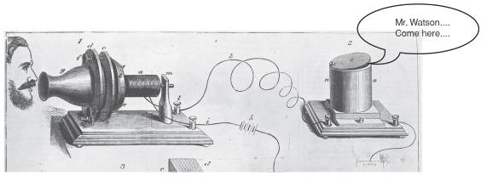
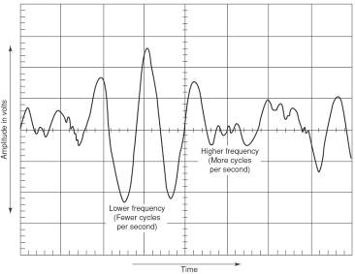
1-2 Numerical Representations
In 1875, Alexander Graham Bell figured out how to change his voice into a continuously variable electrical signal, send it through a wire, and change it back to sound energy at the other end.
Today, the device that converts sound energy to an analog voltage signal is known as a microphone.

Slide 8
1-2 Numerical Representations
Digital Representation—varies in discrete (separate) steps.
Passing time is shown as a change in the display on a digital clock at one minute intervals.
A change in temperature is shown on a digital display only when the temperature changes at least one degree.

Slide 9
1-3 Digital and Analog Systems
Digital system:
A combination of devices that manipulate values represented in digital form.
Analog system:
A combination of devices that manipulate values represented in analog form.

Slide 10
1-3 Digital and Analog Systems
Advantages of digital:
Ease of design
Well suited for storing information.
Accuracy and precision are easier to maintain.
Programmable operation.
Less affected by noise.
Ease of fabrication on IC chips.

Slide 11
1-3 Digital and Analog Systems
There are limits to digital techniques:
The analog nature of the world requires a time consuming conversion process:
Convert the physical variable to an electrical signal (analog).
Convert the analog signal to digital form.
Process (operate on) the digital information.
Convert the digital output back to real-world analog form.

Slide 12
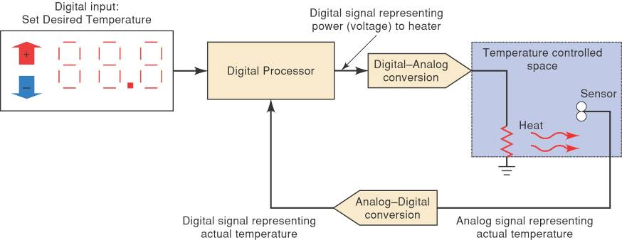
1-3 Digital and Analog Systems
Temperature-regulation system using an analog-to-digital converter.
Digital Systems: Principles and Applications, 11/e
Ronald J. Tocci, Neal S. Widmer, Gregory L. Moss

Slide 13
1-3 Digital and Analog Systems
A digital system is a combination of devices designed to manipulate logical information or physical quantities represented in digital form.
Quantities can take on only discrete values.
An analog system manipulates physical quantities represented in analog form.
Quantities can vary over a continuous range of values.

Slide 14
Digital Progress Today and Tomorrow
There are many needs in the world that digital technology can meet.
You will be able to become one of the pioneers on these new frontiers of technology.

